Slide 1

Document Repository on Django and REACT
By: Harshit Mawandia

Slide 2
Project aim:
Build a web-app to track ongoing projects in the institute (Currently for CSE department)
Allow users to store their documents in a repository
Allow instructors to put up deadlines for evaluations (multiple evaluations)
Allow students to collaborate with other students for a project
Allow multiple supervisors for a project
Enable access control for the instructors to approve a project
Setup OAuth for login for security and privacy reasons
Allow students to raise requests to instructor or committee
Implementing SOLR indexing to search for words or phrases inside documents for easy access

Slide 3
WHY DJANGO & react
We prefer Django and ReactJS for this project over DSpace, due to multiple reasons:
DSpace is an old framework with a restrictive database and design choices
DSpace is restricts separation of backend and frontend, so we have to stick with AngularJS for both which is a relatively old framework and has many deprecated modules.
Django is based on python which has a huge library of packages which can be used directly, like django-haystack(for using SoLR), django-ldap(for integration with openldap), etc.
It provides a built-in django-admin portal for direct access of database for the privileged users.
React allows us to built fully dynamic apps using nodeJS packages, which is better than the DSpace front-end given we want to build a highly interactive web-app.
Separation of backend and frontend allows us to use APIs and allow easy development and debugging.

Slide 4
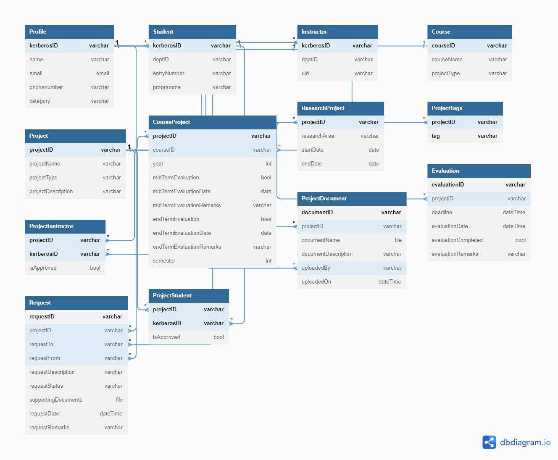
Database Schema

Slide 5
Schema Explained
We have implemented the Schema in the previous file for our PostgreSQL server. Its important characteristics are:
The schema is generic so it can be extended across all departments within or outside IITD with small addition for InstituteName field
The schema allows Instructors to perform as many evaluations as possible for the research projects
The schema design is in BCNF, so there would not be any redundancy in data upon deletion or modification.
Currently, the documents are linked to projects, but the structure of the schema for the documents allows it, so that it does not have to be limited to projects and can be extended to personal documents.

Slide 6
SERVER and HOSTING
We are hosting the backend and frontend on baadalVM.
IP : 10.17.51.131
Domain : docs.iitd.ac.in
Backend is currently hosted on port 443 but needs to be shifted to another port (let's say 8000), as the frontend with SSL will be hosted on 443 when CSC provides an SSL certificate for the same.
We are using Nginx server for hosting, currently up and running on the Virtual Machine

Slide 7
Progress
The database has been setup with the previously mentioned schema, credentials can be shared later.
The backend is up and running on a nginx server on the baadalvm
The login and signup APIs have been integrated with the IITD Oauth 2.0
The API to create projects have been created and tested
The API to create a request has been developed
Session Management has been setup
LDAP has been integrated with the backend and can be accessed if needed
The API for custom user creation upon special request has been created(to be used for people outside IITD)
The Design for the frontend is ready, changes can be made as required.

Slide 8
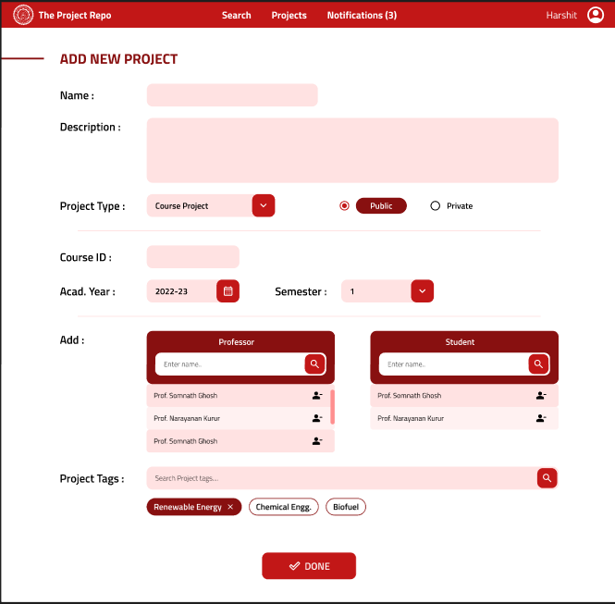
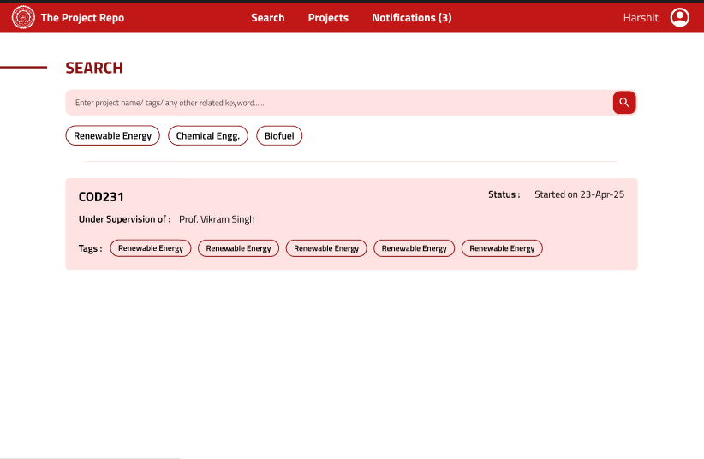
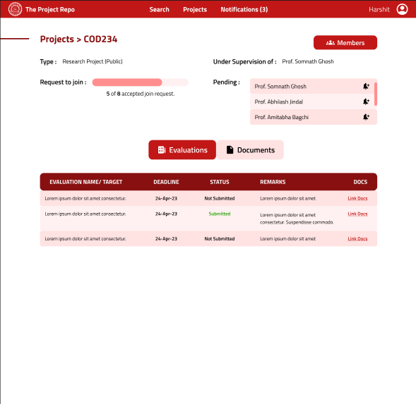
UI - FRONTend

Slide 9
Things Left to do
Getting an SSL certificate from CSC to test the OAuth from the frontend. (might prove to be the bottleneck given past experiences with CSC)
Resetting the ports as required for working with https
Coding the frontend on ReactJS app (Easy but a tedious thing to do)
Creating API to integrate with the frontend as necessary (Best to do while coding the frontend)
Creating access control for Staffs separate from Instructors
Documentation of the code.
Indexing with SoLR for better search experiences. (Tags can only take us so far)

Slide 10
Thank You

